Slide 1
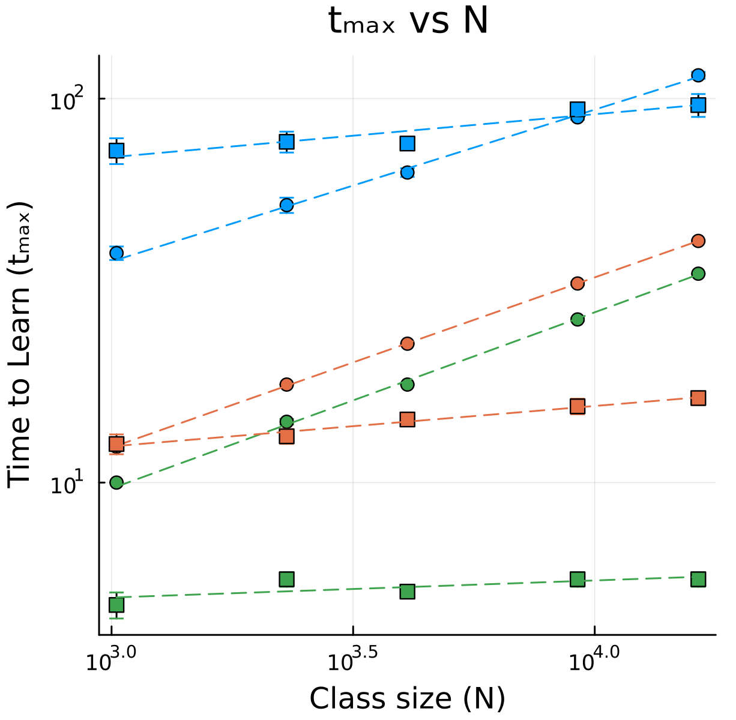
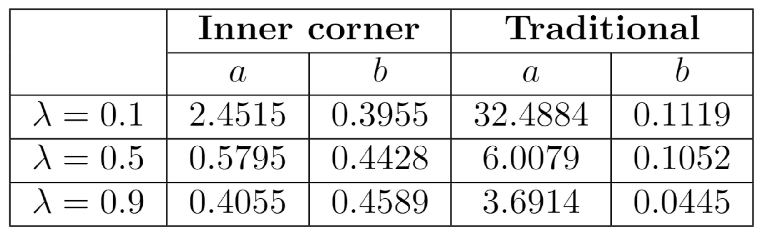
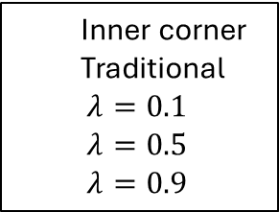
T(0.1)
Inner corner
Traditional
$λ=0.1$
$λ=0.5$
$λ=0.9$
I(0.1)
I(0.5)
I(0.9)
T(0.5)
T(0.9)

Slide 2
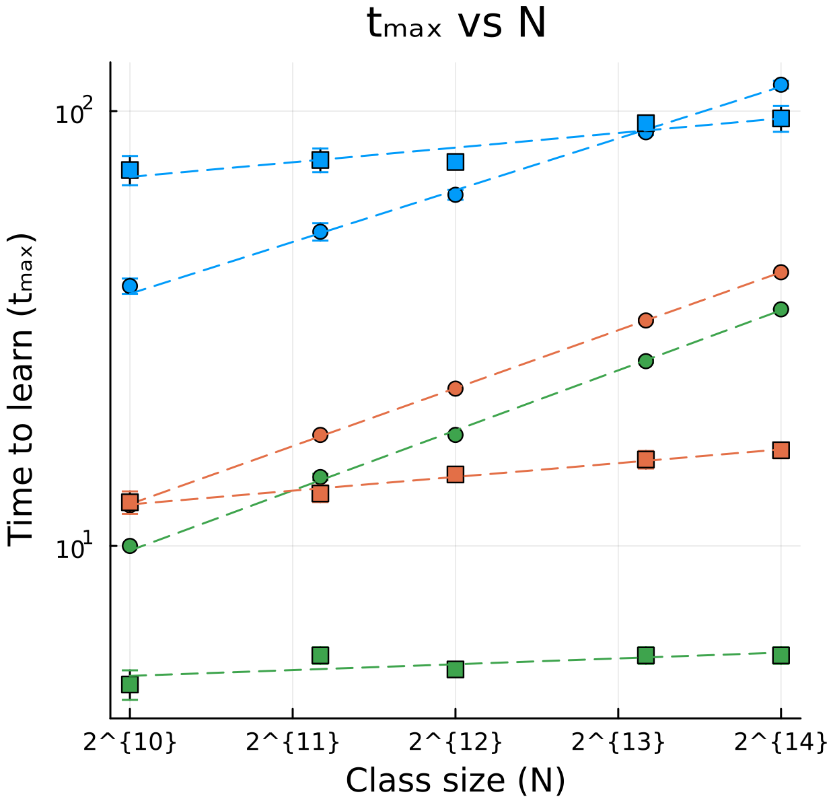

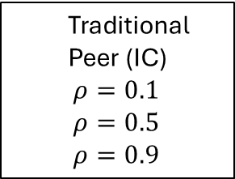





Traditional $(ρ_{0}=0.1)$
Traditional
Peer (IC)
$ρ=0.1$
$ρ=0.5$
$ρ=0.9$
Peer $(ρ_{0}=0.1)$
Peer $(ρ_{0}=0.5)$
Peer $(ρ_{0}=0.9)$
Traditional $(ρ_{0}=0.5)$
Traditional $(ρ_{0}=0.9)$

Slide 3



Inner corner
Center
Outer corner
$$d_{max}=\frac{L\sqrt{2}}{4}$$
$$d_{max}=\frac{L\sqrt{2}}{2}$$
$$d_{max}=\frac{L\sqrt{2}}{2}$$

Slide 4
Inner corner
Center
Outer corner
Random

Slide 5
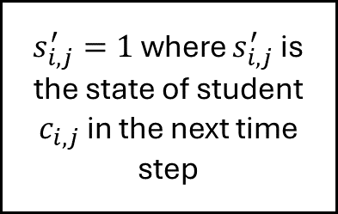
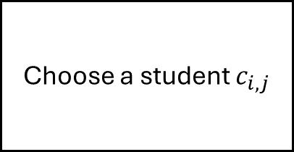
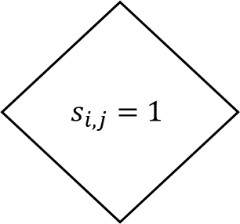
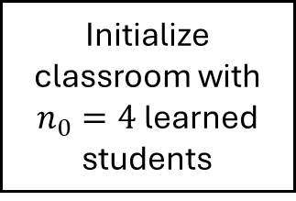
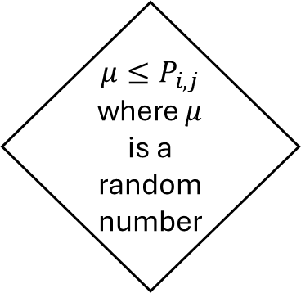
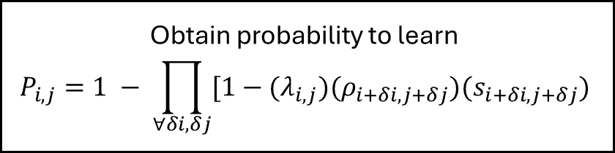
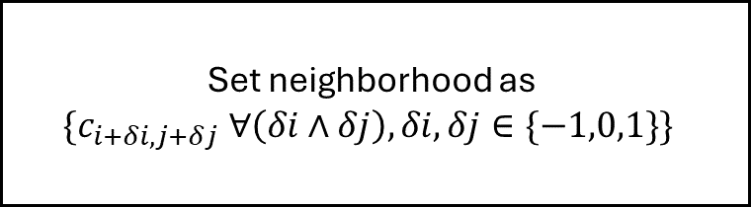
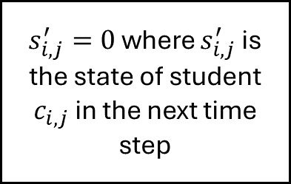
$$s_{i,j}=1$$
Initialize classroom with $n_{0}=4$ learned students
Choose a student $c_{i,j}$
Set neighborhood as
$$\{c_{i+δi,j+δj} ∀\left(δi∧δj\right), δi, δj∈\{−1,0,1\}\}$$
False
True
Obtain probability to learn
$$P_{i,j}=1 − \prod_{∀δi, δj}{[1−(λ_{i,j})(ρ_{i+δi, j+δj})(s_{i+δi, j+δj})}$$
$μ≤P_{i,j}$ where $μ$ is a random number
$s_{i,j}^{′}=0$ where $s_{i,j}^{′}$ is the state of student $c_{i,j}$ in the next time step
$s_{i,j}^{′}=1$ where $s_{i,j}^{′}$ is the state of student $c_{i,j}$ in the next time step
True
False

Slide 6


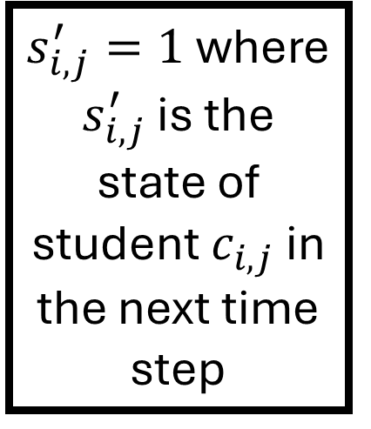
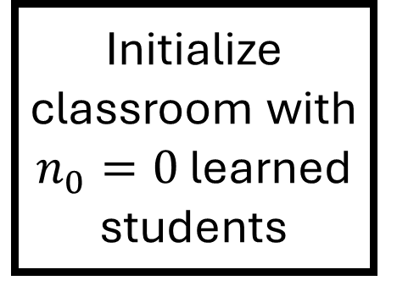


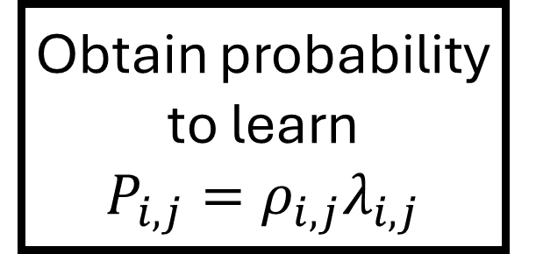

Initialize classroom with $n_{0}=0$ learned students
$$s_{i,j}=1$$
Obtain probability to learn
$$P_{i,j}=ρ_{i,j}λ_{i,j}$$
Begin
Choose a student $c_{i,j}$
False
False
False
Steady state achieved
Done for all $i,j$
End
True
True
True
$μ≤P_{i,j}$ where $μ$ is a random number
$s_{i,j}^{′}=1$ where $s_{i,j}^{′}$ is the state of student $c_{i,j}$ in the next time step
$s_{i,j}^{′}=0$ where $s_{i,j}^{′}$ is the state of student $c_{i,j}$ in the next time step
True
False
One time step

Slide 7
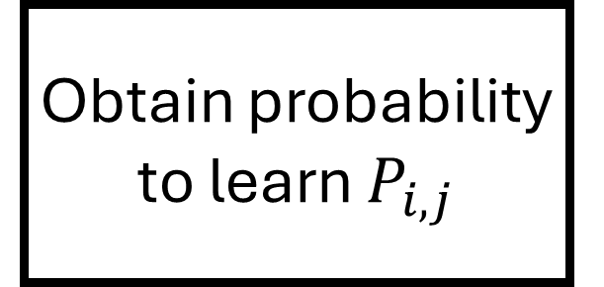
Initialize classroom with $n_{0}=0$ learned students
$$s_{i,j}=1$$
Obtain probability to learn $P_{i,j}$
Begin
Choose a student $c_{i,j}$
False
False
False
Steady state achieved
Done for all $i,j$
End
True
True
True
$μ≤P_{i,j}$ where $μ$ is a random number
$s_{i,j}^{′}=1$ where $s_{i,j}^{′}$ is the state of student $c_{i,j}$ in the next time step
$s_{i,j}^{′}=0$ where $s_{i,j}^{′}$ is the state of student $c_{i,j}$ in the next time step
True
False
One time step

Slide 8



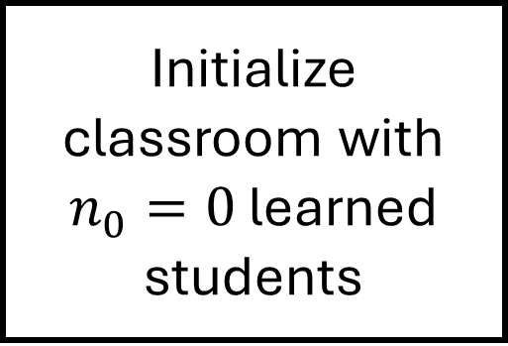


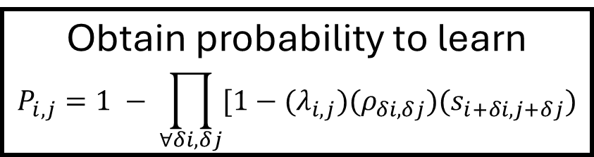

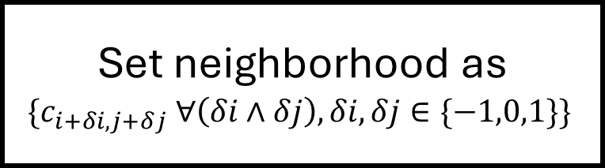
Initialize classroom with $n_{0}=0$ learned students
$$s_{i,j}=1$$
Begin
Choose a student $c_{i,j}$
Set neighborhood as
$$\{c_{i+δi,j+δj} ∀\left(δi∧δj\right), δi, δj∈\{−1,0,1\}\}$$
False
False
False
Steady state achieved
Done for all $i,j$
Obtain probability to learn
$$P_{i,j}=1 − \prod_{∀δi, δj}{[1−(λ_{i,j})(ρ_{δi, δj})(s_{i+δi, j+δj})}$$
End
True
True
True
$s_{i,j}^{′}=0$ where $s_{i,j}^{′}$ is the state of student $c_{i,j}$ in the next time step
$s_{i,j}^{′}=1$ where $s_{i,j}^{′}$ is the state of student $c_{i,j}$ in the next time step
$μ≤P_{i,j}$ where $μ$ is a random number
True
False
One time step

Slide 9
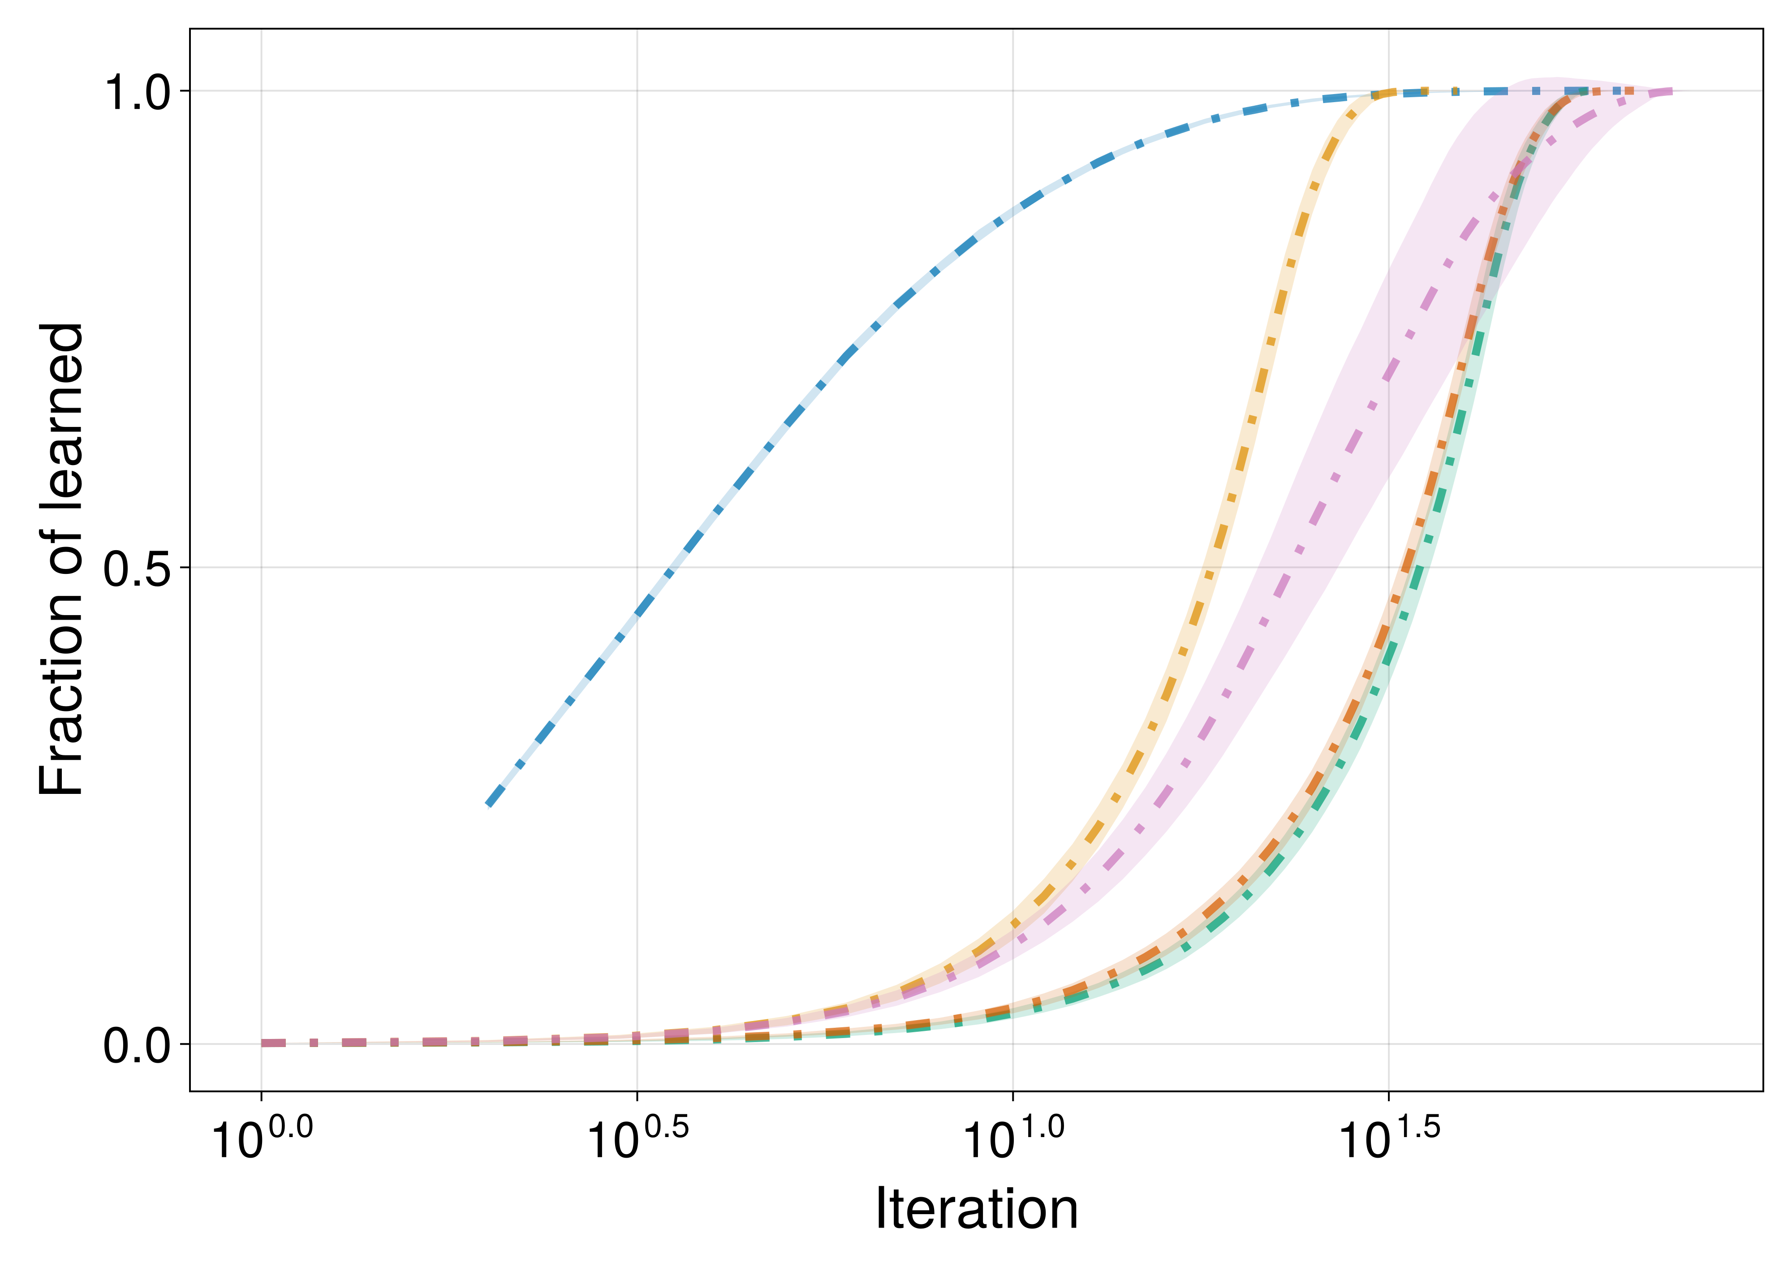
Random
Inner Corner
Center
Traditional
Outer Corner

Slide 10
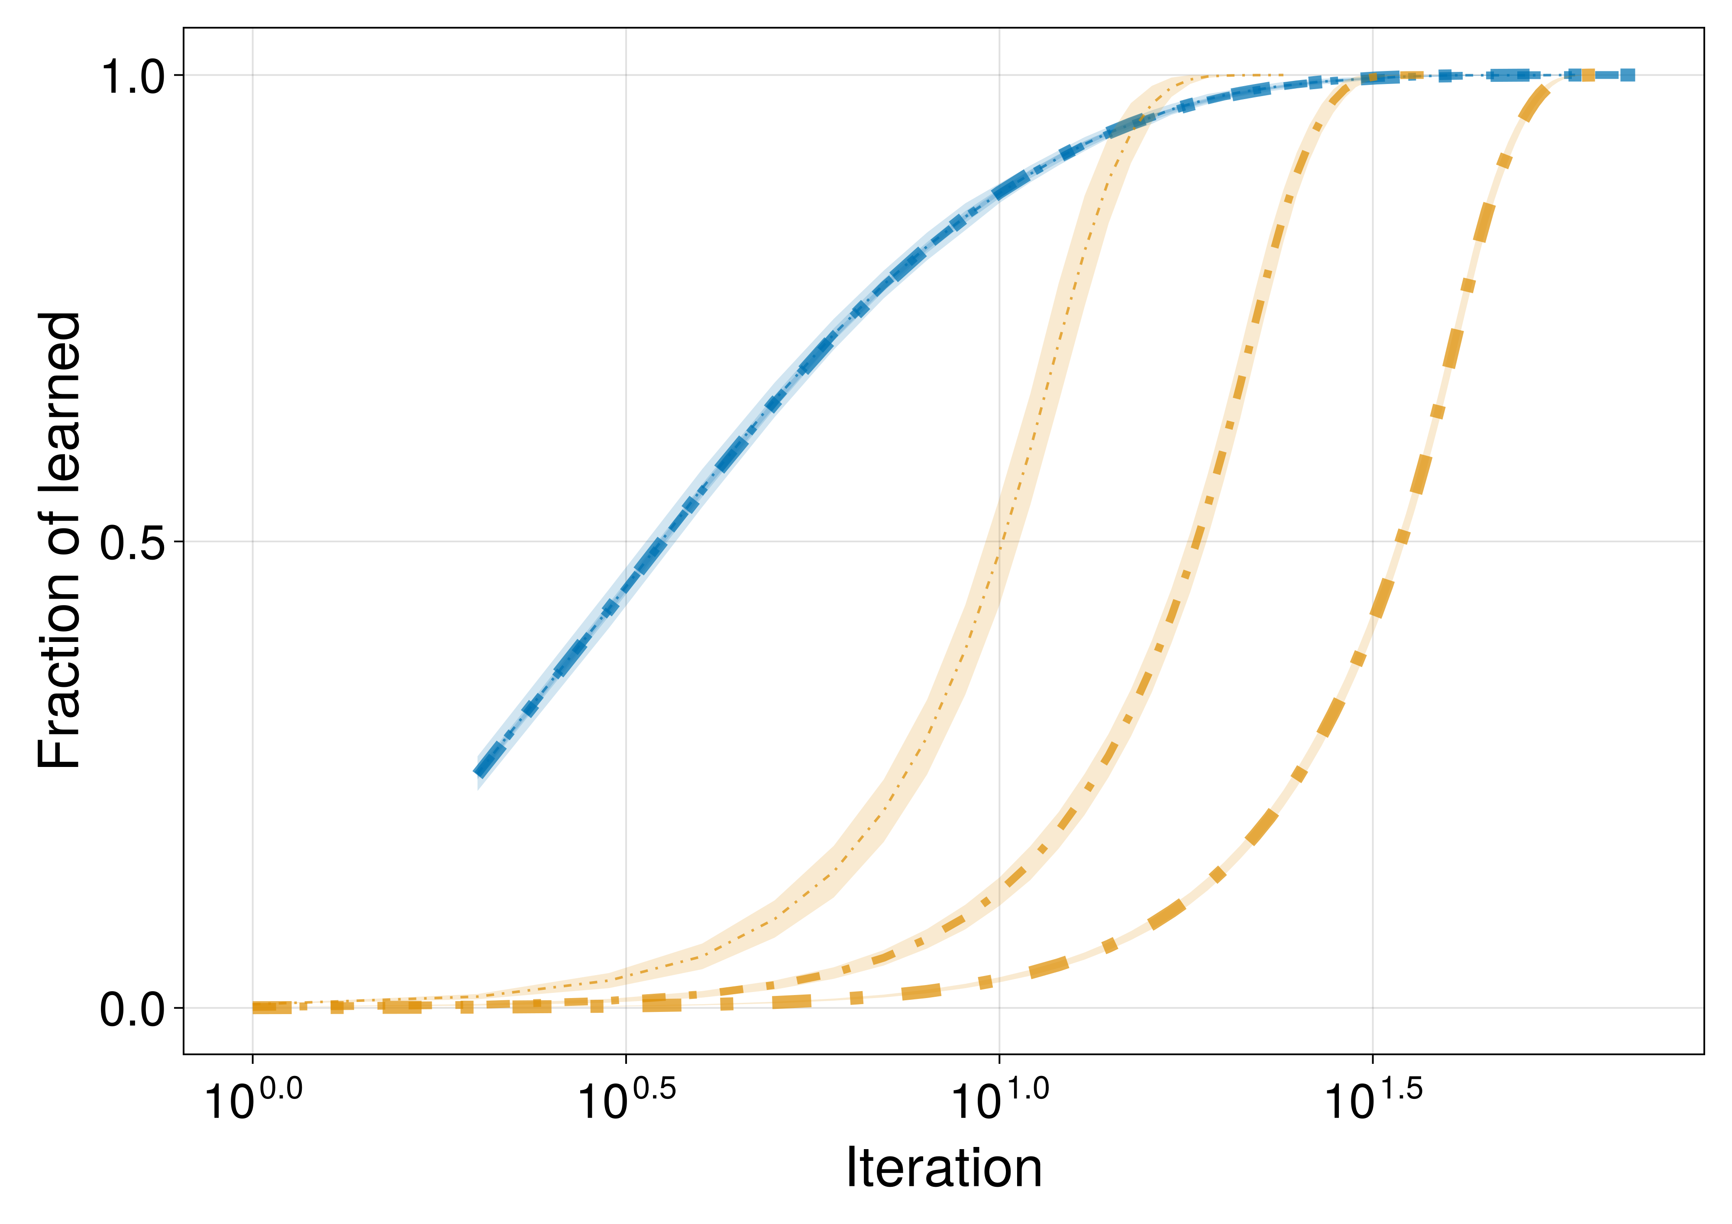
L = 128
L = 32, 64, 128
L = 64
L = 32

Slide 11
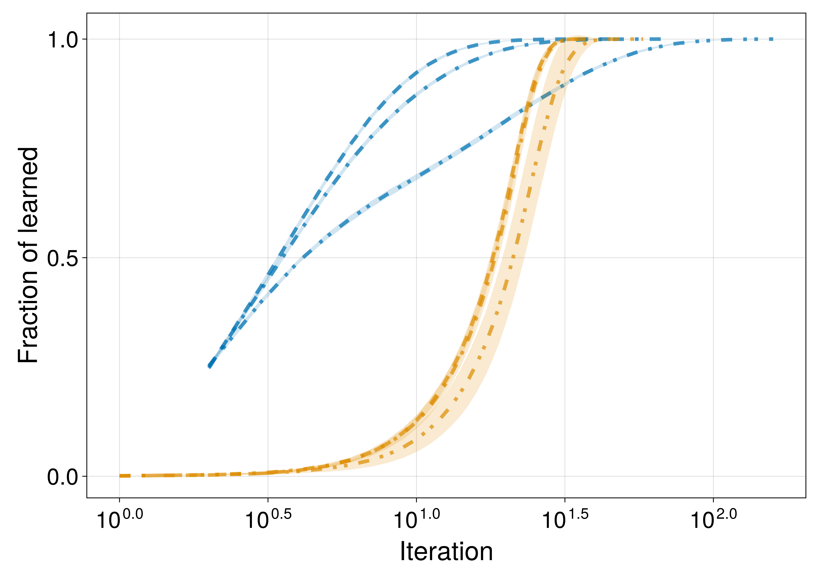
δλ = 0.2
δλ = 0.0
δλ = 0.4
δλ = 0.0, 0.2
δλ = 0.4

Slide 12
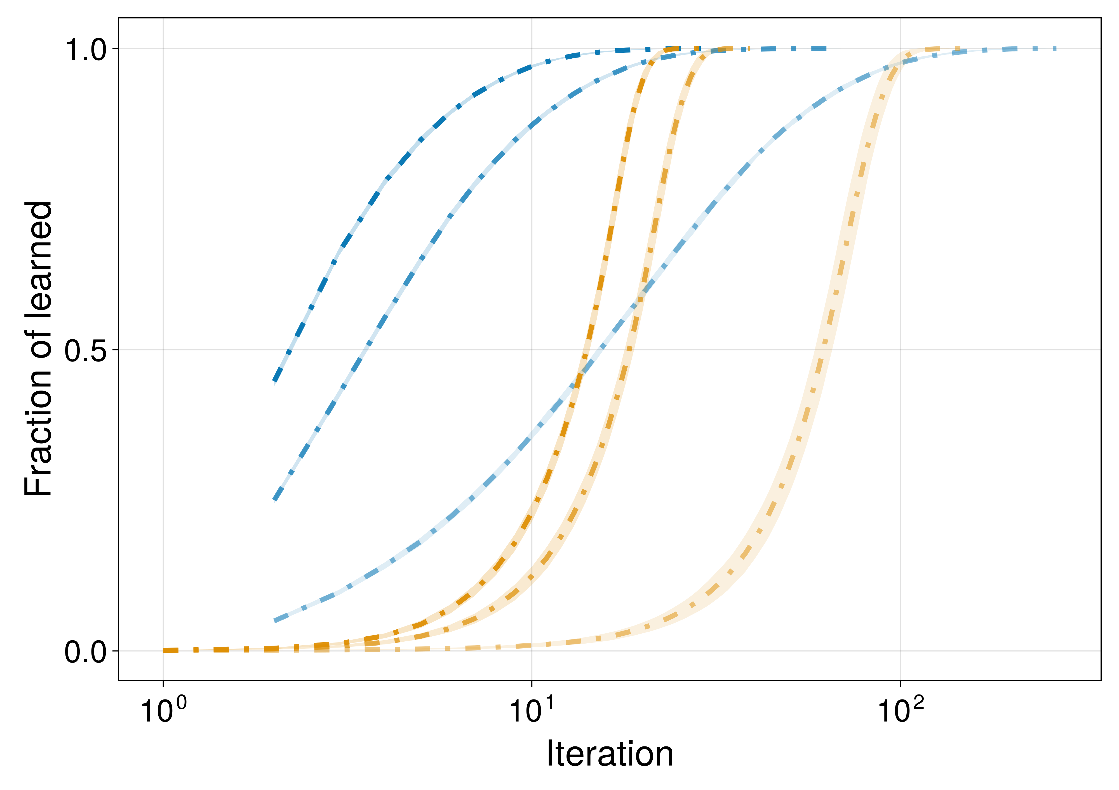
ρ = 0.9
ρ = 0.9
ρ = 0.5
ρ = 0.5
ρ = 0.1
ρ = 0.1

Slide 13
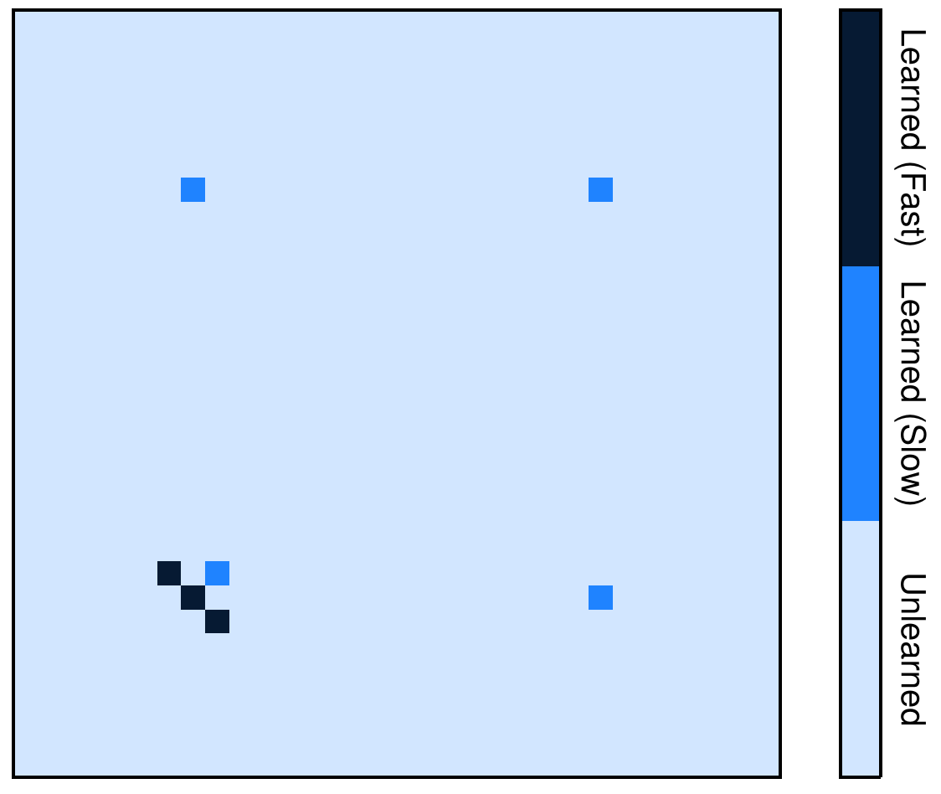
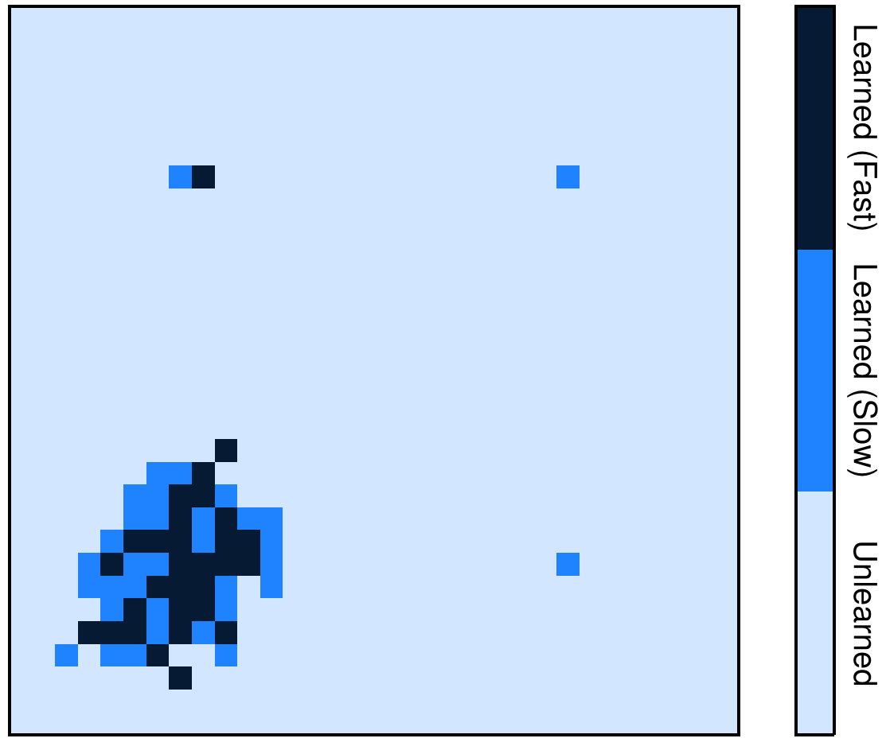
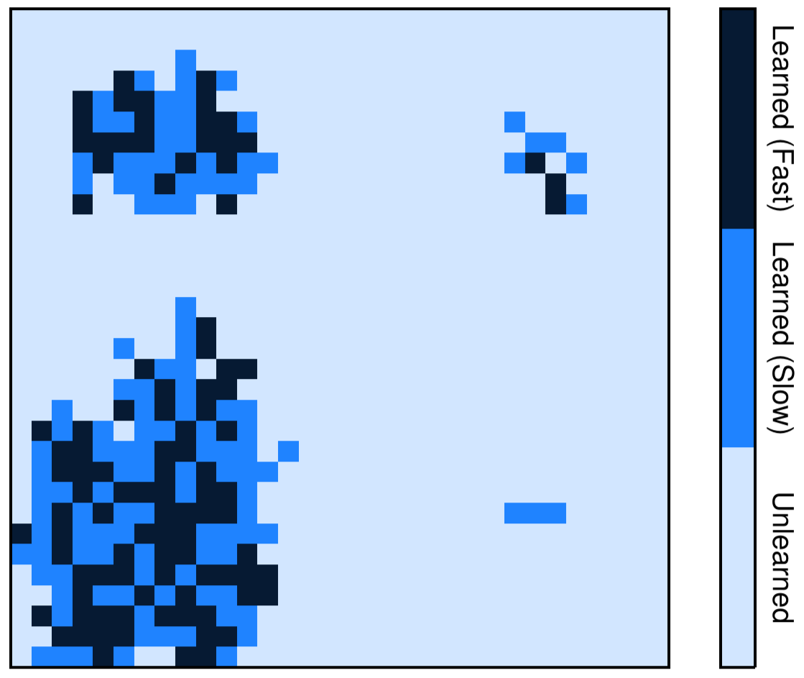
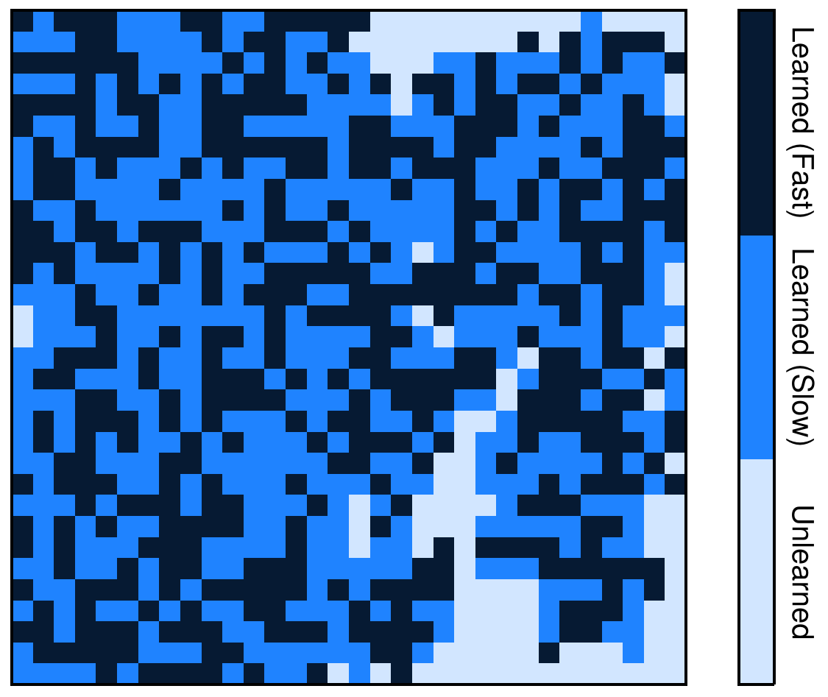
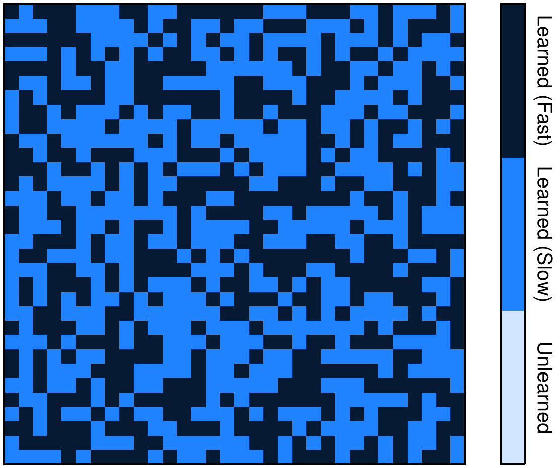

Slide 14
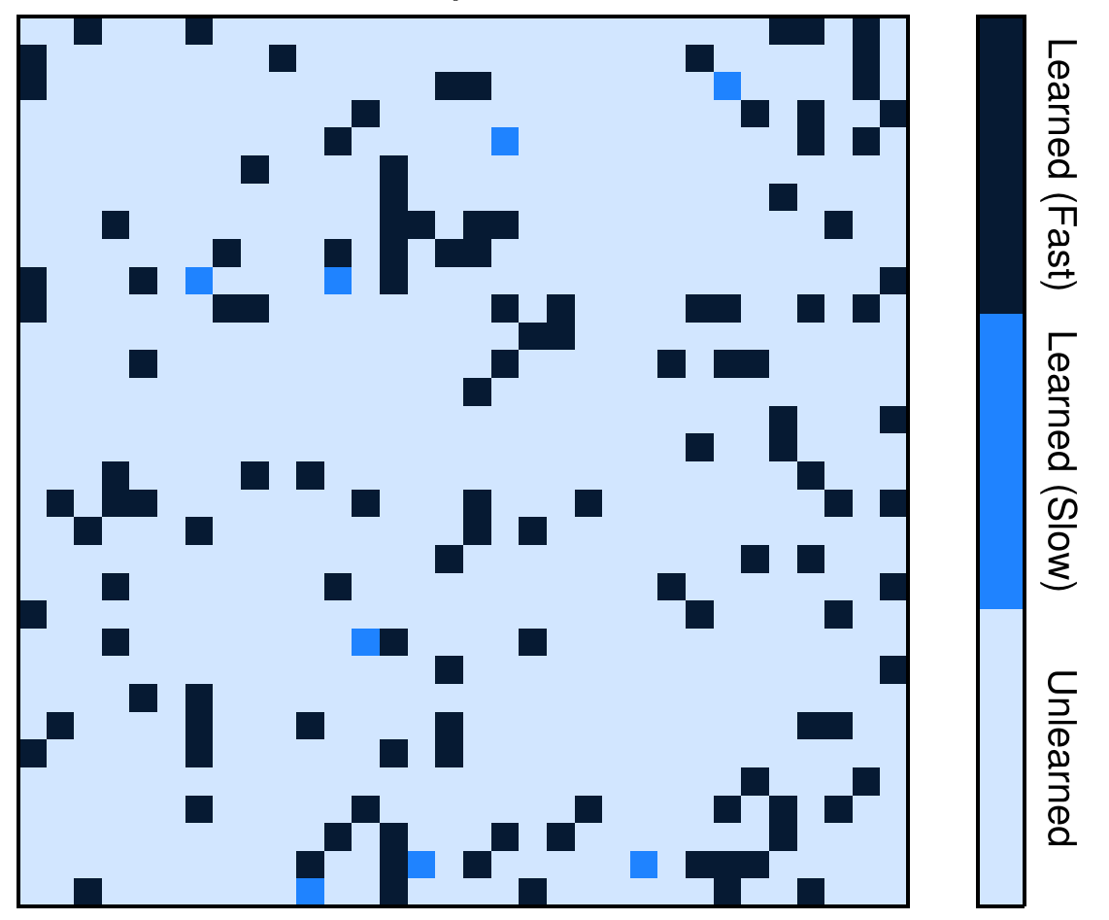
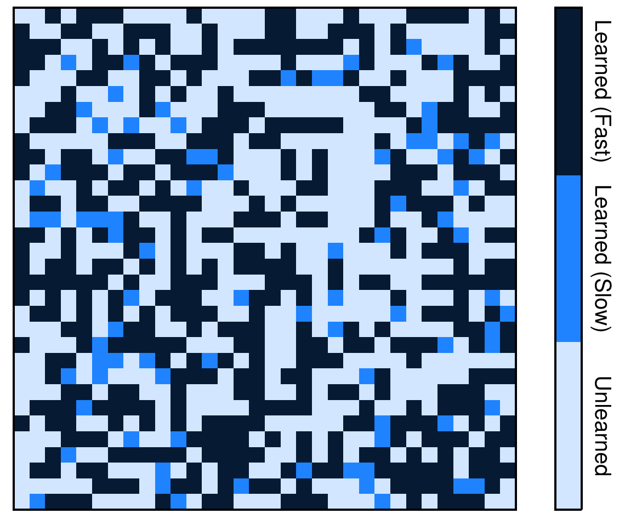
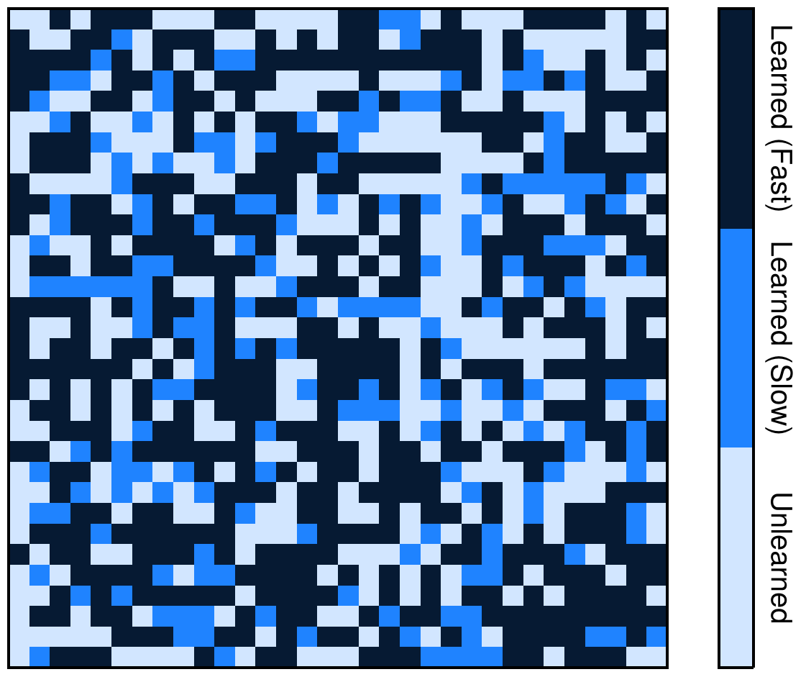
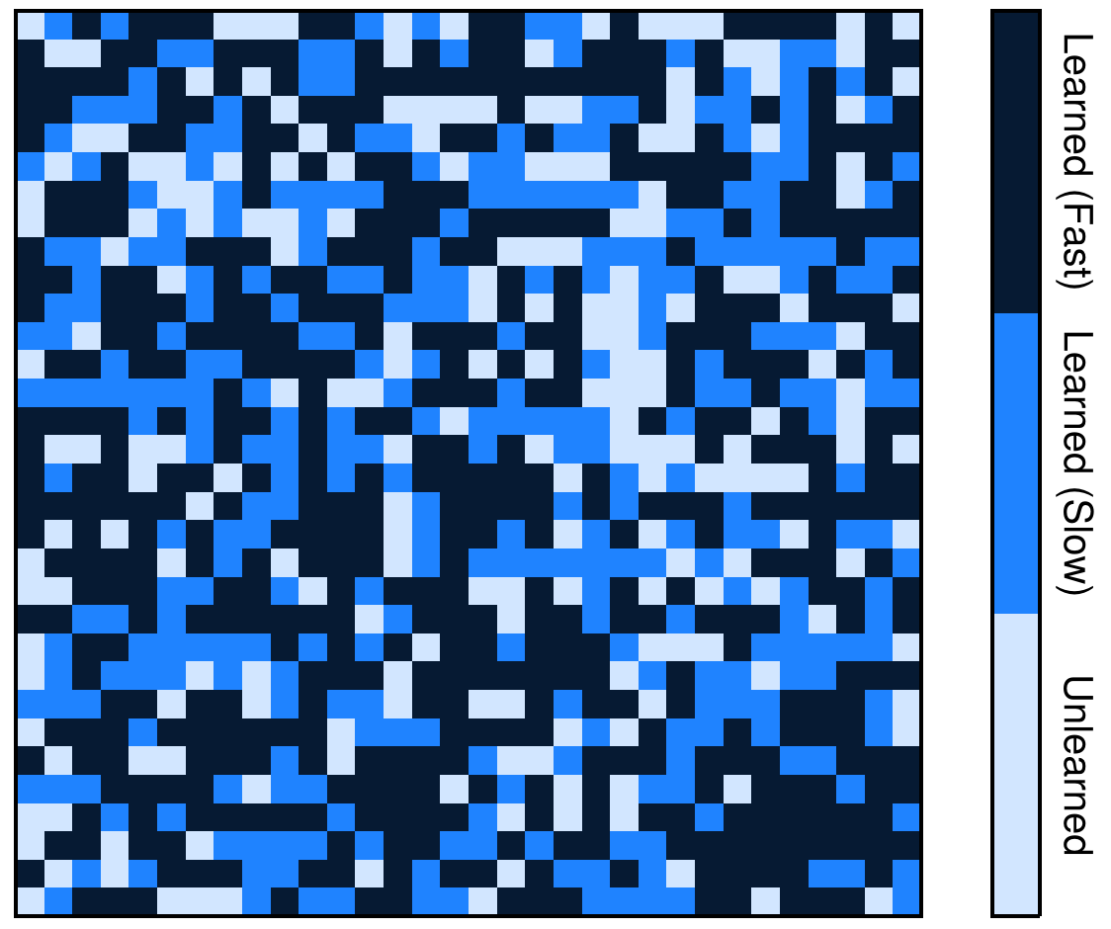
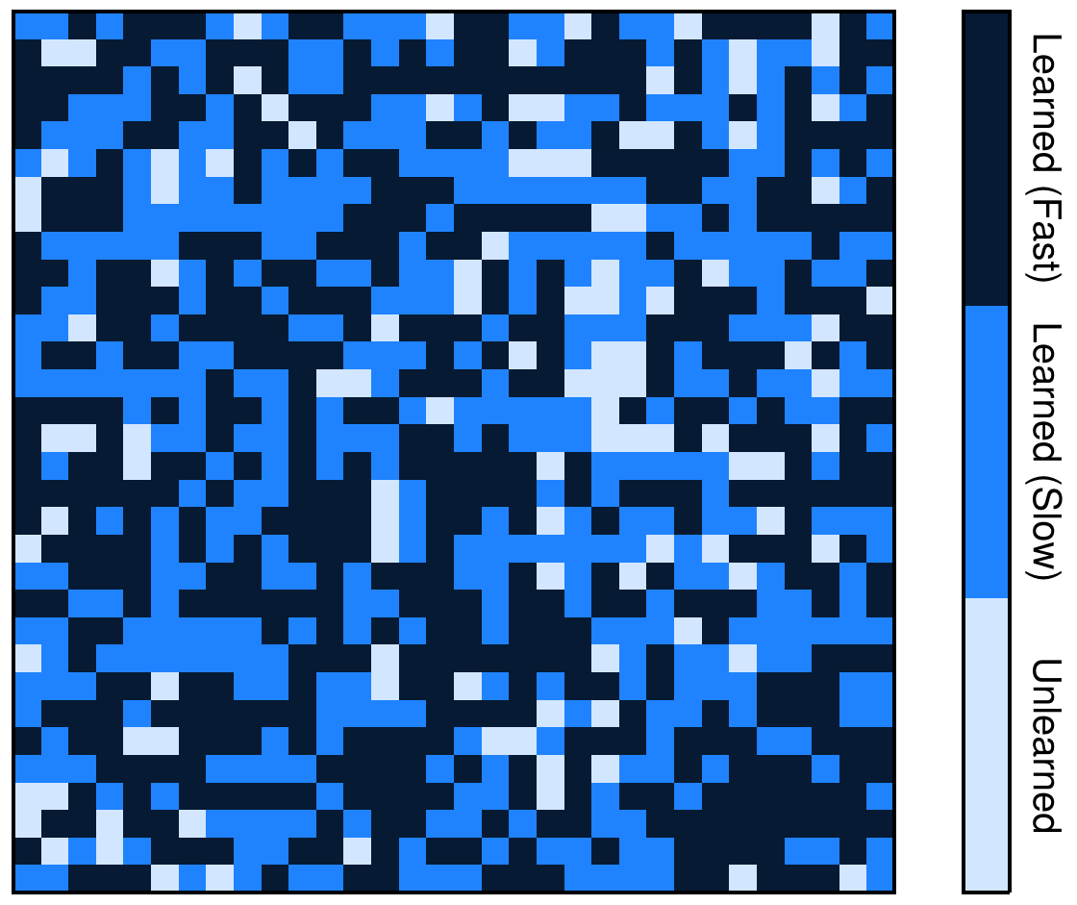

Slide 15










(a) Traditional Instruction (TI)
Learned (fast)
Learned (slow)
Unlearned
$$t=2$$
$$t=8$$
$$t=16$$
$$t=32$$
$$t=54$$
(b) Peer Instruction (PI)
$$t=2$$
$$t=8$$
$$t=16$$
$$t=32$$
$$t=54$$

Slide 16
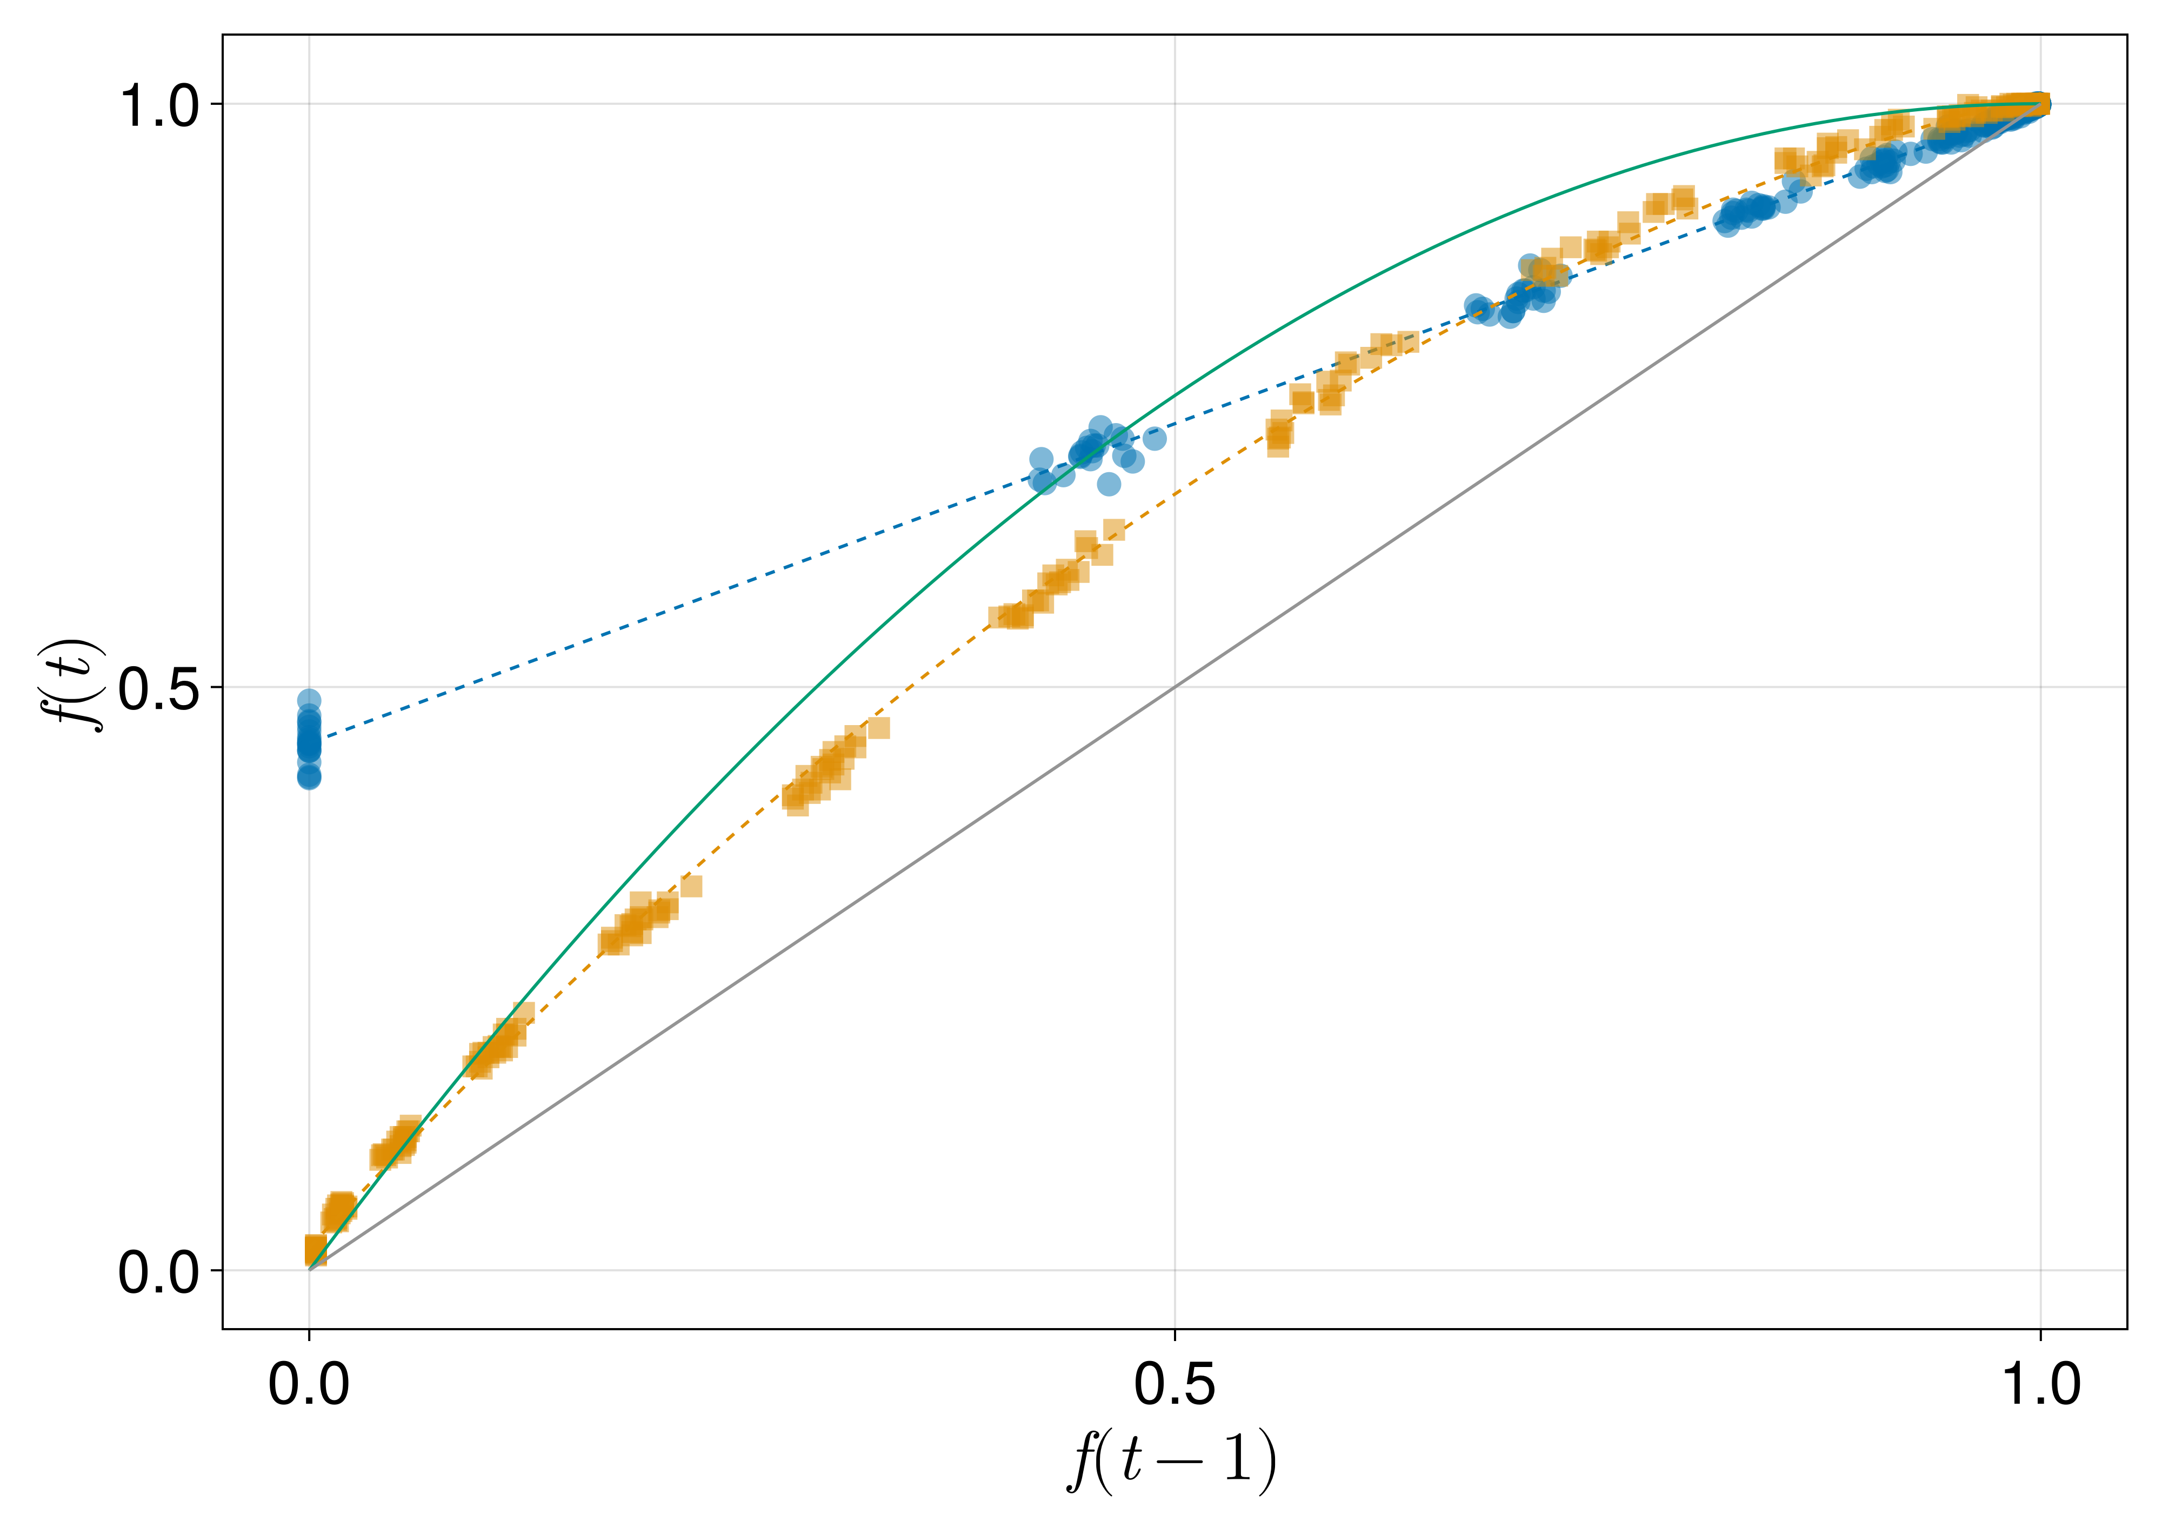
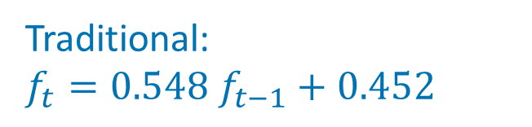
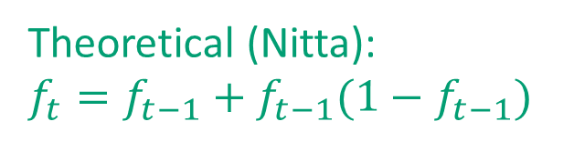
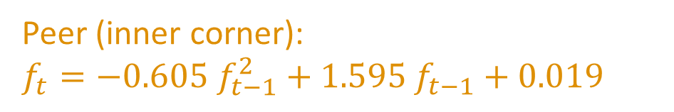
Theoretical (Nitta):
$f_{t}=f_{t−1}+f_{t−1}(1−f_{t−1})$
Traditional:
$f_{t}=0.548 f_{t−1}+0.452$
Peer (inner corner):
$f_{t}=−0.605 f_{t−1}^{2}+1.595 f_{t−1}+0.019$

Slide 17
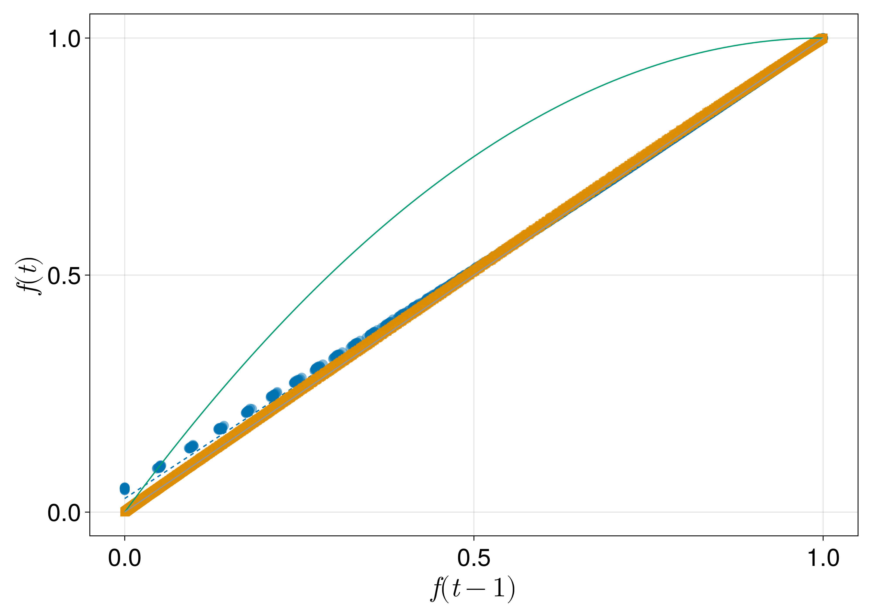
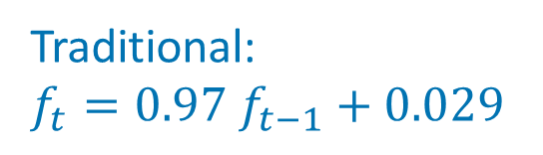


Theoretical (Nitta):
$f_{t}=f_{t−1}+f_{t−1}(1−f_{t−1})$
Peer (inner corner):
$$f_{t}=−0.033 f_{t−1}^{2}+1.033 f_{t−1}+0.0$$
Traditional:
$f_{t}=0.97 f_{t−1}+0.029$

